Slide 1
Classification: Basic Concepts and Decision Trees

Slide 2
A programming task

Slide 3
Classification: Definition
Given a collection of records (training set )
  Each record contains a set of attributes, one of the attributes is the class.
Find a model for class attribute as a function of the values of other attributes.
Goal: previously unseen records should be assigned a class as accurately as possible.
  A test set is used to determine the accuracy of the model. Usually, the given data set is divided into training and test sets, with training set used to build the model and test set used to validate it.

Slide 4

Illustrating Classification Task

Slide 5




Examples of Classification Task
Predicting tumor cells as benign or malignant
Classifying credit card transactions
as legitimate or fraudulent
Classifying secondary structures of protein
as alpha-helix, beta-sheet, or random
coil
Categorizing news stories as finance,
weather, entertainment, sports, etc

Slide 6
Classification Using Distance
Place items in class to which they are “closest”.
Must determine distance between an item and a class.
Classes represented by
  Centroid: Central value.
  Medoid: Representative point.
  Individual points
Algorithm: KNN

Slide 7
K Nearest Neighbor (KNN):
Training set includes classes.
Examine K items near item to be classified.
New item placed in class with the most number of close items.
O(q) for each tuple to be classified. (Here q is the size of the training set.)

Slide 8
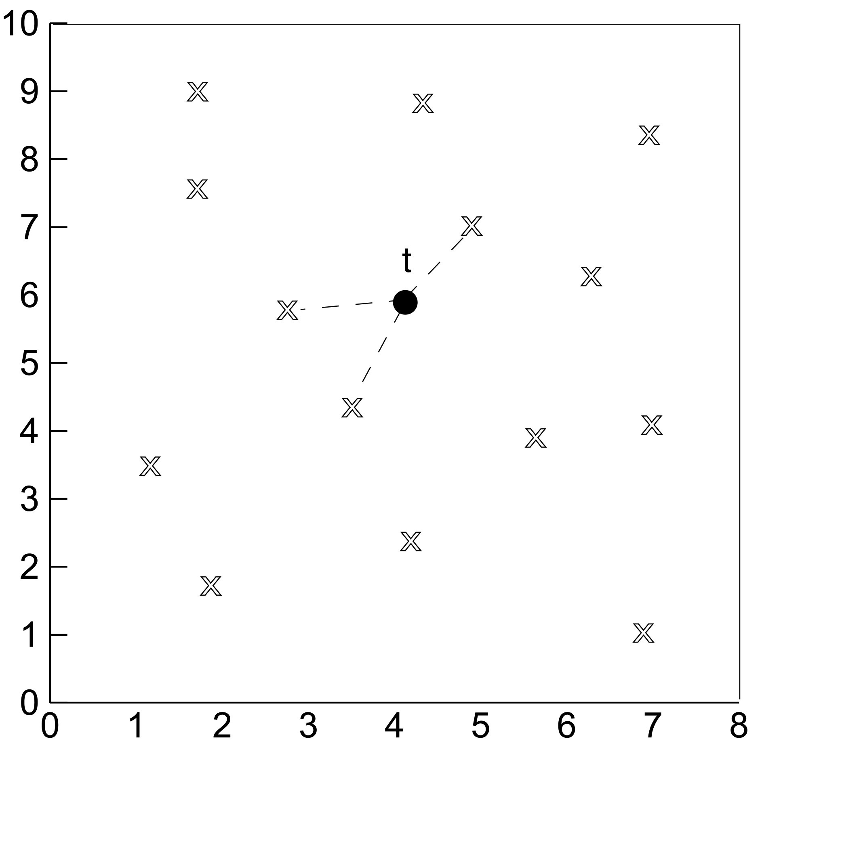
KNN

Slide 9
Classification Techniques
Decision Tree based Methods
Rule-based Methods
Memory based reasoning
Neural Networks
Naïve Bayes and Bayesian Belief Networks
Support Vector Machines

Slide 10

Example of a Decision Tree
categorical
categorical
continuous
class
Splitting Attributes
Refund
Yes
No
NO
MarSt
Single, Divorced
Married
TaxInc
NO
< 80K
> 80K
NO
YES
Training Data
Model: Decision Tree

Slide 11
Another Example of Decision Tree
categorical
categorical
continuous
class
MarSt
Single, Divorced
Married
NO
Refund
Yes
No
NO
TaxInc
< 80K
> 80K
NO
YES
There could be more than one tree that fits the same data!

Slide 12

Decision Tree Classification Task
Decision Tree

Slide 13

Apply Model to Test Data
Test Data
Start from the root of tree.
Refund
Yes
No
NO
MarSt
Single, Divorced
Married
TaxInc
NO
< 80K
> 80K
NO
YES

Slide 14
Apply Model to Test Data
Test Data
Refund
Yes
No
NO
MarSt
Single, Divorced
Married
TaxInc
NO
< 80K
> 80K
NO
YES

Slide 15

Apply Model to Test Data
Test Data
Refund
Yes
No
NO
MarSt
Single, Divorced
Married
TaxInc
NO
< 80K
> 80K
NO
YES

Slide 16
Apply Model to Test Data
Test Data
Refund
Yes
No
NO
MarSt
Single, Divorced
Married
TaxInc
NO
< 80K
> 80K
NO
YES

Slide 17

Apply Model to Test Data
Test Data
Refund
Yes
No
NO
MarSt
Single, Divorced
Married
TaxInc
NO
< 80K
> 80K
NO
YES

Slide 18
Apply Model to Test Data
Test Data
Refund
Yes
No
NO
MarSt
Single, Divorced
Married
Assign Cheat to “No”
TaxInc
NO
< 80K
> 80K
NO
YES

Slide 19

Decision Tree Classification Task
Decision Tree

Slide 20
Decision Tree Induction
Many Algorithms:
  Hunt’s Algorithm (one of the earliest)
  CART
  ID3, C4.5
  SLIQ,SPRINT

Slide 21

General Structure of Hunt’s Algorithm
Let D_{t} be the set of training records that reach a node t
General Procedure:
  If D_{t} contains records that belong the same class y_{t}, then t is a leaf node labeled as y_{t}
  If D_{t} is an empty set, then t is a leaf node labeled by the default class, y_{d}
  If D_{t} contains records that belong to more than one class, use an attribute test to split the data into smaller subsets. Recursively apply the procedure to each subset.
D_{t}
?

Slide 22

Hunt’s Algorithm
Refund
Don’t
Cheat
Yes
No
Don’t
Cheat
Don’t
Cheat
Refund
Refund
Yes
No
Yes
No
Don’t
Cheat
Marital
Status
Don’t
Cheat
Marital
Status
Single,
Divorced
Single,
Divorced
Married
Married
Cheat
Don’t
Cheat
Taxable
Income
Don’t
Cheat
< 80K
>= 80K
Don’t
Cheat
Cheat

Slide 23
Tree Induction
Greedy strategy.
  Split the records based on an attribute test that optimizes certain criterion.
Issues
  Determine how to split the records
    How to specify the attribute test condition?
    How to determine the best split?
  Determine when to stop splitting

Slide 24
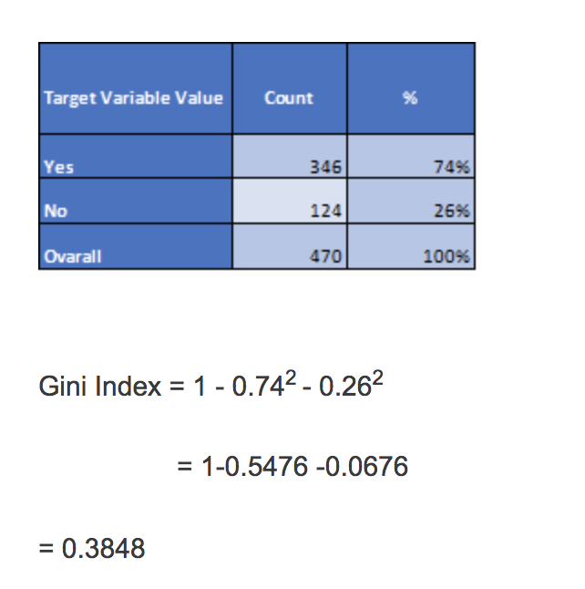
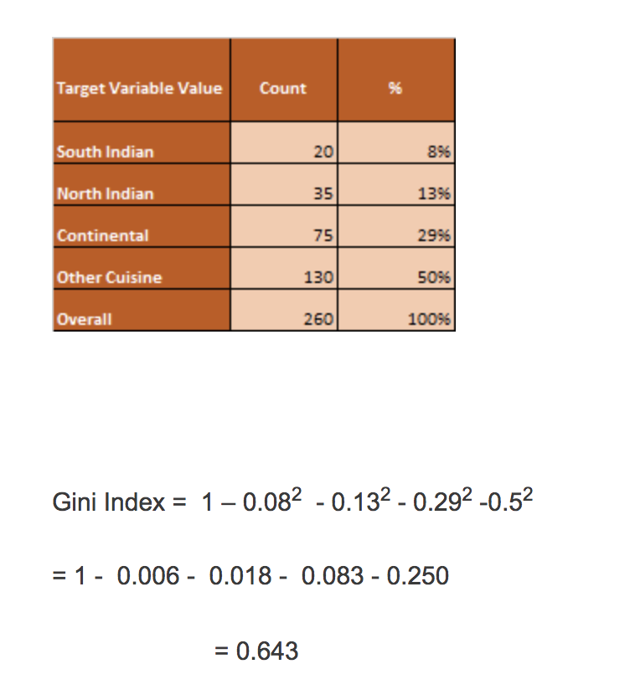
Gini Index Example

Slide 25
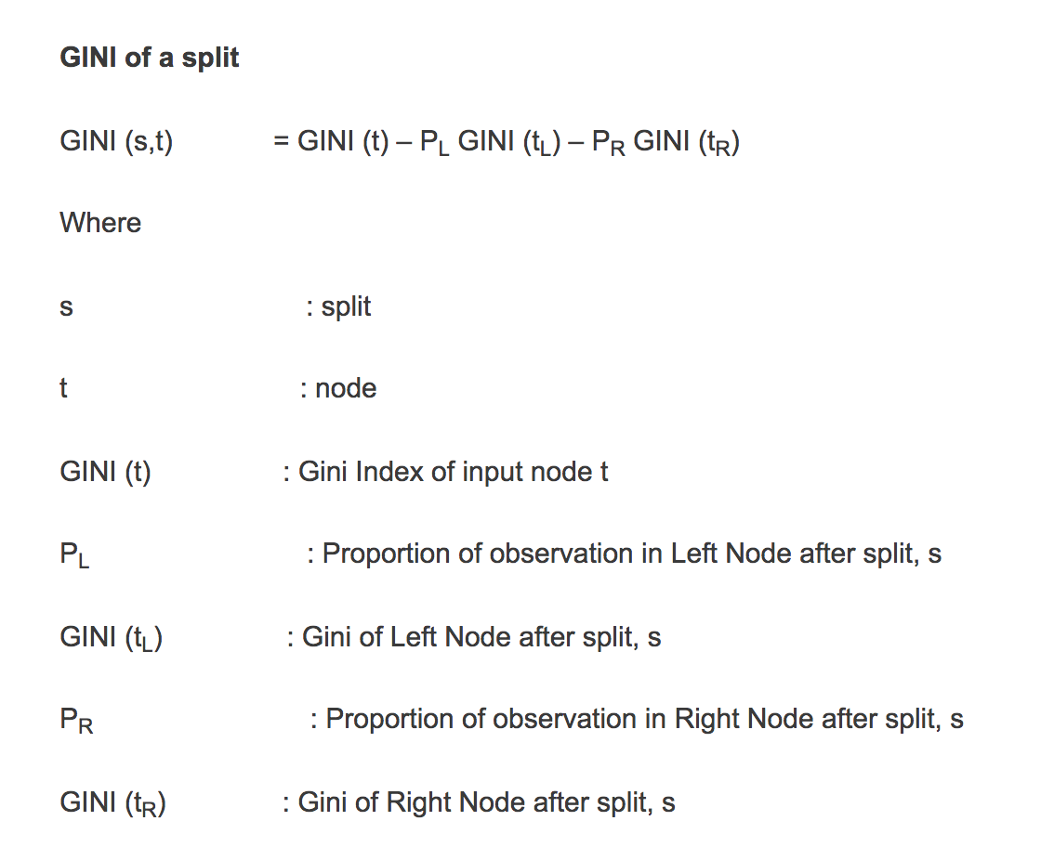
Gini of a Split

Slide 26
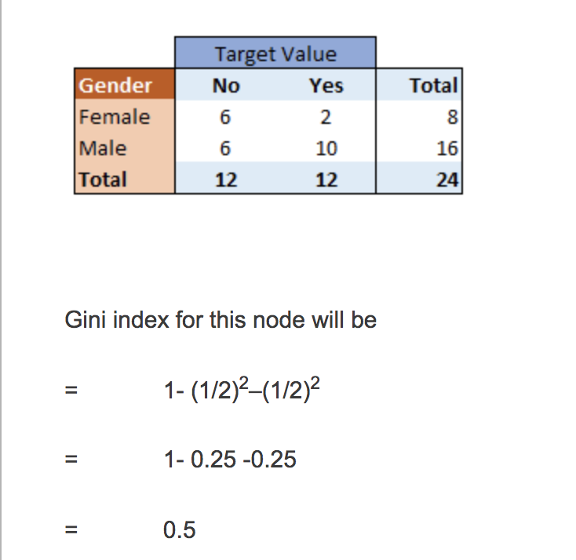
Gini of a Split - Example

Slide 27
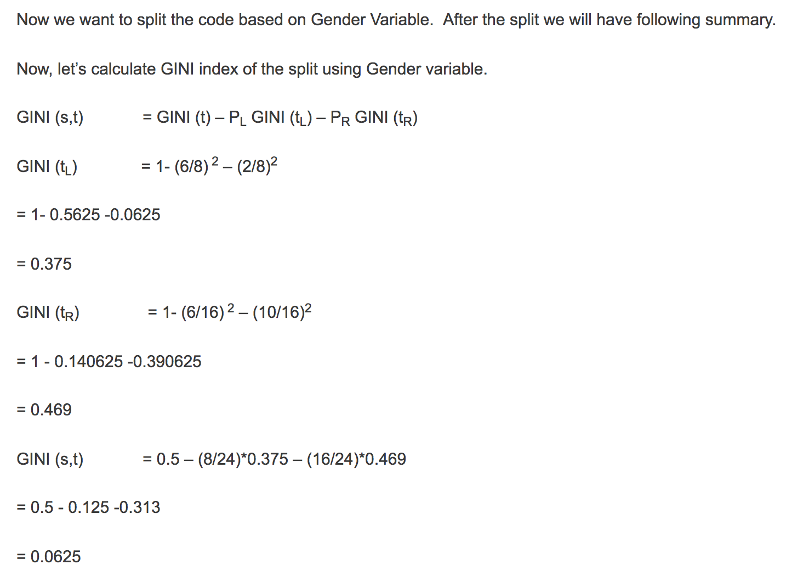
Gini Index of a Split

Slide 28
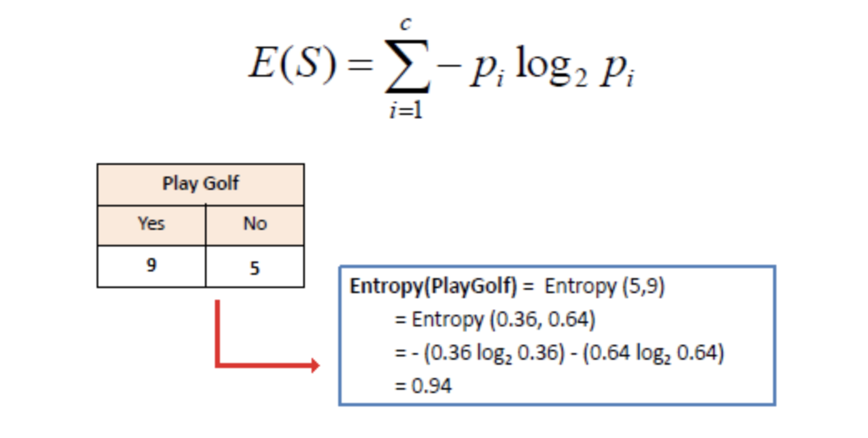
Entropy

Slide 29
Tree Induction
Greedy strategy.
  Split the records based on an attribute test that optimizes certain criterion.
Issues
  Determine how to split the records
    How to specify the attribute test condition?
    How to determine the best split?
  Determine when to stop splitting

Slide 30
How to Specify Test Condition?
Depends on attribute types
  Nominal
  Ordinal
  Continuous
Depends on number of ways to split
  2-way split
  Multi-way split

Slide 31
Splitting Based on Nominal Attributes
Multi-way split: Use as many partitions as distinct values.
Binary split: Divides values into two subsets.
Need to find optimal partitioning.
CarType
Family
Luxury
Sports
CarType
OR
CarType
{Sports, Luxury}
{Family,
Luxury}
{Family}
{Sports}

Slide 32
Splitting Based on Ordinal Attributes
Multi-way split: Use as many partitions as distinct values.
Binary split: Divides values into two subsets.
Need to find optimal partitioning.
What about this split?
Size
Small
Large
Medium
Size
Size
{Small, Medium}
OR
{Medium,
Large}
{Large}
{Small}
Size
{Small, Large}
{Medium}

Slide 33
Splitting Based on Continuous Attributes
Different ways of handling
  Discretization to form an ordinal categorical attribute
    Static – discretize once at the beginning
    Dynamic – ranges can be found by equal interval bucketing, equal frequency bucketing
    (percentiles), or clustering.
  Binary Decision: (A < v) or (A ≥ v)
    consider all possible splits and finds the best cut
    can be more compute intensive

Slide 34
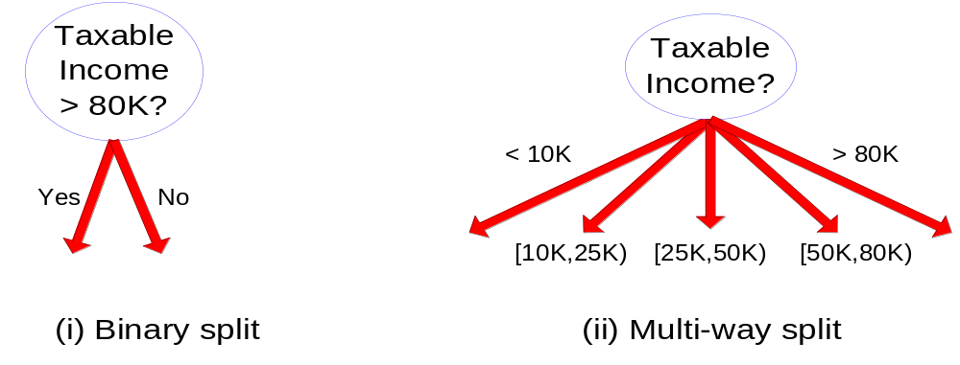
Splitting Based on Continuous Attributes

Slide 35
Tree Induction
Greedy strategy.
  Split the records based on an attribute test that optimizes certain criterion.
Issues
  Determine how to split the records
    How to specify the attribute test condition?
    How to determine the best split?
  Determine when to stop splitting

Slide 36

How to determine the Best Split
Before Splitting: 10 records of class 0,
10 records of class 1
Which test condition is the best?

Slide 37


How to determine the Best Split
Greedy approach:
  Nodes with homogeneous class distribution are preferred
Need a measure of node impurity:
Non-homogeneous,
High degree of impurity
Homogeneous,
Low degree of impurity

Slide 38
Measures of Node Impurity
Gini Index
Entropy
Misclassification error

Slide 39





How to Find the Best Split
Before Splitting:
M0
A?
B?
Yes
No
Yes
No
Node N1
Node N2
Node N3
Node N4
M1
M2
M3
M4
M12
M34
Gain = M0 – M12 vs M0 – M34

Slide 40





Measure of Impurity: GINI
Gini Index for a given node t :
    (NOTE: p( j | t) is the relative frequency of class j at node t).
  Maximum (1 - 1/n_{c}) when records are equally distributed among all classes, implying least interesting information
  Minimum (0.0) when all records belong to one class, implying most interesting information

Slide 41



Examples for computing GINI
P(C1) = 0/6 = 0 P(C2) = 6/6 = 1
Gini = 1 – P(C1)² – P(C2)² = 1 – 0 – 1 = 0
P(C1) = 1/6 P(C2) = 5/6
Gini = 1 – (1/6)² – (5/6)² = 0.278
P(C1) = 2/6 P(C2) = 4/6
Gini = 1 – (2/6)² – (4/6)² = 0.444

Slide 42

Splitting Based on GINI
Used in CART, SLIQ, SPRINT.
When a node p is split into k partitions (children), the quality of split is computed as,
where, n_{i} = number of records at child i,
n = number of records at node p.

Slide 43

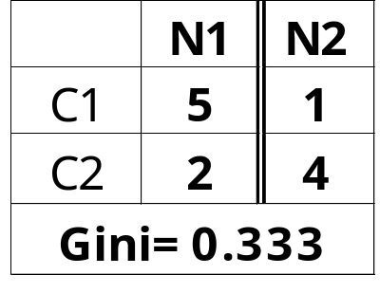
Binary Attributes: Computing GINI Index
Splits into two partitions
Effect of Weighing partitions:
  Larger and Purer Partitions are sought for.
B?
Yes
No
Node N1
Node N2
Gini(N1)
= 1 – (5/6)² – (2/6)²
= 0.194
Gini(N2)
= 1 – (1/6)² – (4/6)²
= 0.528
Gini(Children)
= 7/12 * 0.194 +
5/12 * 0.528
= 0.333

Slide 44



Categorical Attributes: Computing Gini Index
For each distinct value, gather counts for each class in the dataset
Use the count matrix to make decisions
Multi-way split
Two-way split
(find best partition of values)

Slide 45

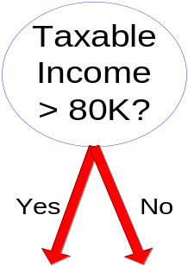
Continuous Attributes: Computing Gini Index
Use Binary Decisions based on one value
Several Choices for the splitting value
  Number of possible splitting values
  = Number of distinct values
Each splitting value has a count matrix associated with it
  Class counts in each of the partitions, A < v and A ≥ v
Simple method to choose best v
  For each v, scan the database to gather count matrix and compute its Gini index
  Computationally Inefficient! Repetition of work.

Slide 46

Continuous Attributes: Computing Gini Index...
For efficient computation: for each attribute,
  Sort the attribute on values
  Linearly scan these values, each time updating the count matrix and computing gini index
  Choose the split position that has the least gini index
Sorted Values
Split Positions

Slide 47

Alternative Splitting Criteria based on INFO
Entropy at a given node t:
    (NOTE: p( j | t) is the relative frequency of class j at node t).
  Measures homogeneity of a node.
    Maximum (log n_{c}) when records are equally distributed among all classes implying least information
    Minimum (0.0) when all records belong to one class, implying most information
  Entropy based computations are similar to the GINI index computations

Slide 48

Examples for computing Entropy
P(C1) = 0/6 = 0 P(C2) = 6/6 = 1
Entropy = – 0 log 0 – 1 log 1 = – 0 – 0 = 0
P(C1) = 1/6 P(C2) = 5/6
Entropy = – (1/6) log₂ (1/6) – (5/6) log₂ (1/6) = 0.65
P(C1) = 2/6 P(C2) = 4/6
Entropy = – (2/6) log₂ (2/6) – (4/6) log₂ (4/6) = 0.92

Slide 49

Splitting Based on INFO...
Information Gain:
    Parent Node, p is split into k partitions;
    n_{i} is number of records in partition i
  Measures Reduction in Entropy achieved because of the split. Choose the split that achieves most reduction (maximizes GAIN)
  Used in ID3 and C4.5
  Disadvantage: Tends to prefer splits that result in large number of partitions, each being small but pure.

Slide 50


Splitting Based on INFO...
Gain Ratio:
    Parent Node, p is split into k partitions
    n_{i} is the number of records in partition i
  Adjusts Information Gain by the entropy of the partitioning (SplitINFO). Higher entropy partitioning (large number of small partitions) is penalized!
  Used in C4.5
  Designed to overcome the disadvantage of Information Gain

Slide 51

Splitting Criteria based on Classification Error
Classification error at a node t :
Measures misclassification error made by a node.
    Maximum (1 - 1/n_{c}) when records are equally distributed among all classes, implying least interesting information
    Minimum (0.0) when all records belong to one class, implying most interesting information

Slide 52
Examples for Computing Error
P(C1) = 0/6 = 0 P(C2) = 6/6 = 1
Error = 1 – max (0, 1) = 1 – 1 = 0
P(C1) = 1/6 P(C2) = 5/6
Error = 1 – max (1/6, 5/6) = 1 – 5/6 = 1/6
P(C1) = 2/6 P(C2) = 4/6
Error = 1 – max (2/6, 4/6) = 1 – 4/6 = 1/3

Slide 53

Comparison among Splitting Criteria
For a 2-class problem:

Slide 54

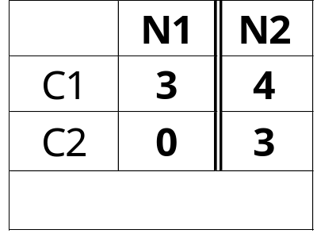
Misclassification Error vs Gini
A?
Yes
No
Node N1
Node N2
Gini(N1)
= 1 – (3/3)² – (0/3)²
= 0
Gini(N2)
= 1 – (4/7)² – (3/7)²
= 0.489
Gini(Children)
= 3/10 * 0
+ 7/10 * 0.489
= 0.342

Slide 55
Tree Induction
Greedy strategy.
  Split the records based on an attribute test that optimizes certain criterion.
Issues
  Determine how to split the records
    How to specify the attribute test condition?
    How to determine the best split?
  Determine when to stop splitting

Slide 56
Stopping Criteria for Tree Induction
Stop expanding a node when all the records belong to the same class
Stop expanding a node when all the records have similar attribute values
Early termination (to be discussed later)

Slide 57
Decision Tree Based Classification
Advantages:
  Inexpensive to construct
  Extremely fast at classifying unknown records
  Easy to interpret for small-sized trees
  Accuracy is comparable to other classification techniques for many simple data sets

Slide 58
Example: C4.5
Simple depth-first construction.
Uses Information Gain
Sorts Continuous Attributes at each node.
Needs entire data to fit in memory.
Unsuitable for Large Datasets.
  Needs out-of-core sorting.
You can download the software from:
http://www.cse.unsw.edu.au/~quinlan/c4.5r8.tar.gz

Slide 59
Practical Issues of Classification
Underfitting and Overfitting
Missing Values
Costs of Classification

Slide 60

Underfitting and Overfitting (Example)
500 circular and 500 triangular data points.
Circular points:
0.5 ≤ sqrt(x₁²+x₂²) ≤ 1
Triangular points:
sqrt(x₁²+x₂²) > 0.5 or
sqrt(x₁²+x₂²) < 1

Slide 61

Underfitting and Overfitting
Overfitting
Underfitting: when model is too simple, both training and test errors are large

Slide 62

Overfitting due to Noise
Decision boundary is distorted by noise point

Slide 63

Overfitting due to Insufficient Examples
Lack of data points in the lower half of the diagram makes it difficult to predict correctly the class labels of that region
- Insufficient number of training records in the region causes the decision tree to predict the test examples using other training records that are irrelevant to the classification task

Slide 64
Notes on Overfitting
Overfitting results in decision trees that are more complex than necessary
Training error no longer provides a good estimate of how well the tree will perform on previously unseen records
Need new ways for estimating errors

Slide 65
Estimating Generalization Errors
Re-substitution errors: error on training (Σ e(t) )
Generalization errors: error on testing (Σ e’(t))
Methods for estimating generalization errors:
  Optimistic approach: e’(t) = e(t)
  Pessimistic approach:
    For each leaf node: e’(t) = (e(t)+0.5)
    Total errors: e’(T) = e(T) + N × 0.5 (N: number of leaf nodes)
    For a tree with 30 leaf nodes and 10 errors on training
    (out of 1000 instances):
    Training error = 10/1000 = 1%
    Generalization error = (10 + 30×0.5)/1000 = 2.5%
  Reduced error pruning (REP):
    uses validation data set to estimate generalization
    error

Slide 66
Occam’s Razor
Given two models of similar generalization errors, one should prefer the simpler model over the more complex model
For complex models, there is a greater chance that it was fitted accidentally by errors in data
Therefore, one should include model complexity when evaluating a model

Slide 67
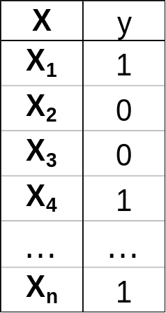
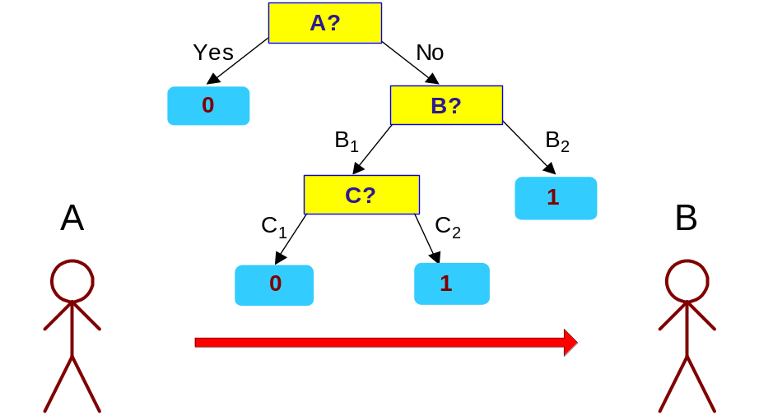
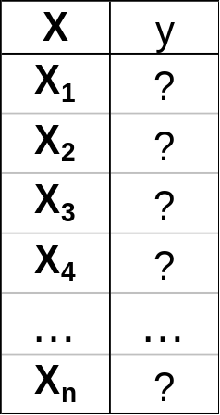
Minimum Description Length (MDL)
Cost(Model,Data) = Cost(Data|Model) + Cost(Model)
  Cost is the number of bits needed for encoding.
  Search for the least costly model.
Cost(Data|Model) encodes the misclassification errors.
Cost(Model) uses node encoding (number of children) plus splitting condition encoding.

Slide 68
How to Address Overfitting
Pre-Pruning (Early Stopping Rule)
  Stop the algorithm before it becomes a fully-grown tree
  Typical stopping conditions for a node:
    Stop if all instances belong to the same class
    Stop if all the attribute values are the same
  More restrictive conditions:
    Stop if number of instances is less than some user-specified threshold
    Stop if class distribution of instances are independent of the available features (e.g., using χ ² test)
    Stop if expanding the current node does not improve impurity
    measures (e.g., Gini or information gain).

Slide 69
How to Address Overfitting…
Post-pruning
  Grow decision tree to its entirety
  Trim the nodes of the decision tree in a bottom-up fashion
  If generalization error improves after trimming, replace sub-tree by a leaf node.
  Class label of leaf node is determined from majority class of instances in the sub-tree
  Can use MDL for post-pruning

Slide 70
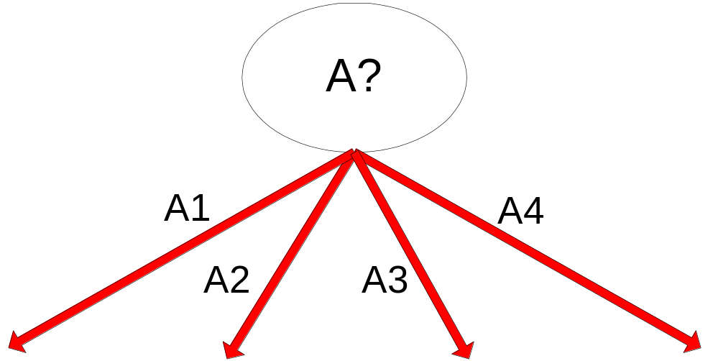
Example of Post-Pruning
Training Error (Before splitting) = 10/30
Pessimistic error = (10 + 0.5)/30 = 10.5/30
Training Error (After splitting) = 9/30
Pessimistic error (After splitting)
= (9 + 4 × 0.5)/30 = 11/30
PRUNE!
Class = Yes | 20
Class = No | 10
Error = 10/30
Class = Yes | 8
Class = No | 4
Class = Yes | 3
Class = No | 4
Class = Yes | 4
Class = No | 1
Class = Yes | 5
Class = No | 1

Slide 71
Examples of Post-pruning
Case 1:
  Optimistic error?
  Pessimistic error?
  Reduced error pruning?
Don’t prune for both cases
C0: 11
C1: 3
C0: 2
C1: 4
Don’t prune case 1, prune case 2
Case 2:
Depends on validation set
C0: 14
C1: 3
C0: 2
C1: 2

Slide 72
Handling Missing Attribute Values
Missing values affect decision tree construction in three different ways:
  Affects how impurity measures are computed
  Affects how to distribute instance with missing value to child nodes
  Affects how a test instance with missing value is classified

Slide 73

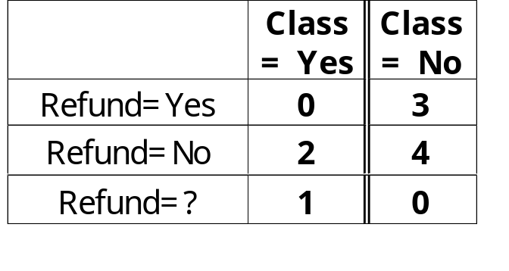
Computing Impurity Measure
Before Splitting:
Entropy(Parent)
= -0.3 log(0.3)-(0.7)log(0.7) = 0.8813
Split on Refund:
Entropy(Refund=Yes) = 0
Entropy(Refund=No)
= -(2/6)log(2/6) – (4/6)log(4/6) = 0.9183
Entropy(Children)
= 0.3 (0) + 0.6 (0.9183) = 0.551
Gain = 0.9 × (0.8813 – 0.551) = 0.3303
Missing value

Slide 74
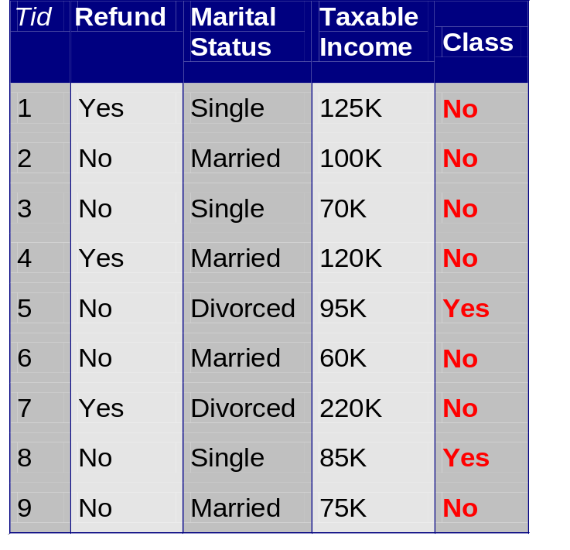
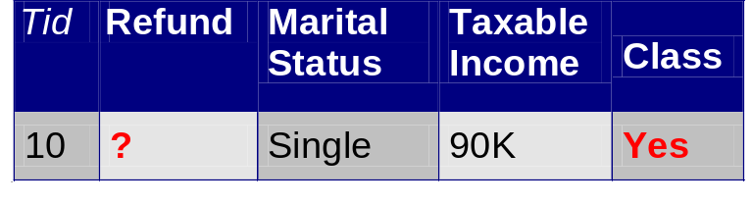
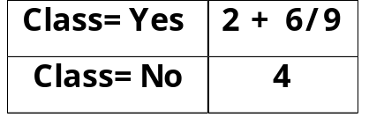
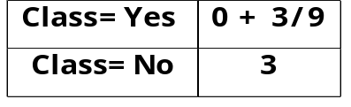
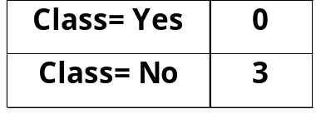
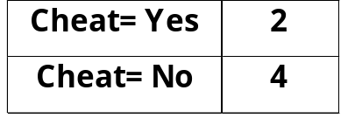
Distribute Instances
Refund
Yes
No
Probability that Refund=Yes is 3/9
Probability that Refund=No is 6/9
Assign record to the left child with weight = 3/9 and to the right child with weight = 6/9
Refund
Yes
No

Slide 75
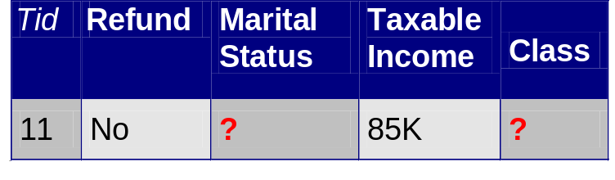
Classify Instances
New record:
 | Married | Single | Divorced | Total
Class=No | 3 | 1 | 0 | 4
Class=Yes | 6/9 | 1 | 1 | 2.67
Total | 3.67 | 2 | 1 | 6.67
Refund
Yes
No
NO
MarSt
Single,
Divorced
Married
Probability that Marital Status
= Married is 3.67/6.67
Probability that Marital Status ={Single,Divorced} is 3/6.67
TaxInc
NO
< 80K
> 80K
NO
YES

Slide 76
Scalable Decision Tree Induction Methods
SLIQ (EDBT’96 — Mehta et al.)
  Builds an index for each attribute and only class list and the current attribute list reside in memory
SPRINT (VLDB’96 — J. Shafer et al.)
  Constructs an attribute list data structure
PUBLIC (VLDB’98 — Rastogi & Shim)
  Integrates tree splitting and tree pruning: stop growing the tree earlier
RainForest (VLDB’98 — Gehrke, Ramakrishnan & Ganti)
  Builds an AVC-list (attribute, value, class label)
BOAT (PODS’99 — Gehrke, Ganti, Ramakrishnan & Loh)
  Uses bootstrapping to create several small samples

